Slide 1


PROJECT TITLE
DEVSECOPS PIPELINE
Aryan Bamne
Souvik Kumar Pramanik
Somya Jain
Chirayu Humar
31 January 2026

Slide 2
NEED FOR PIPELINE
To Avoid Manual Testing, Deployment, Image Building
To Avoid Repetative Use of Similar Commands and Processes

Slide 3
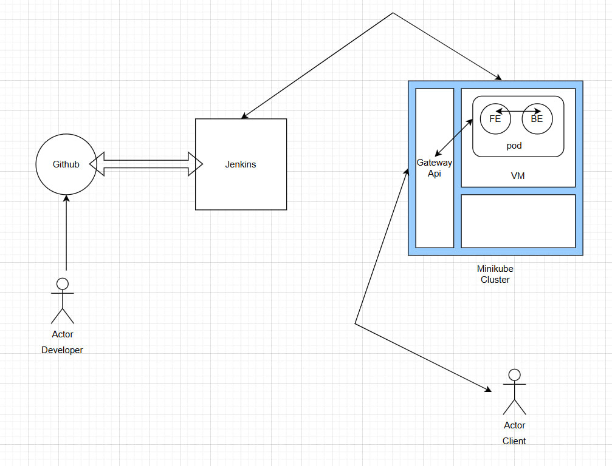
High Level Architecture
JENKINS HANDLES EVERYTHING
All the Pipeline stages are mentioned in Jenkins.

Slide 4
Pipeline Overview
Code Quality Analysis with SonarQube
Vulnerability Scanning using Trivy
Building Docker image using Docker
Docker Image is Pushed to Docker Hub
Deployment On Kubernetes
Monitoring Using Prometheus and Grafana

Slide 5
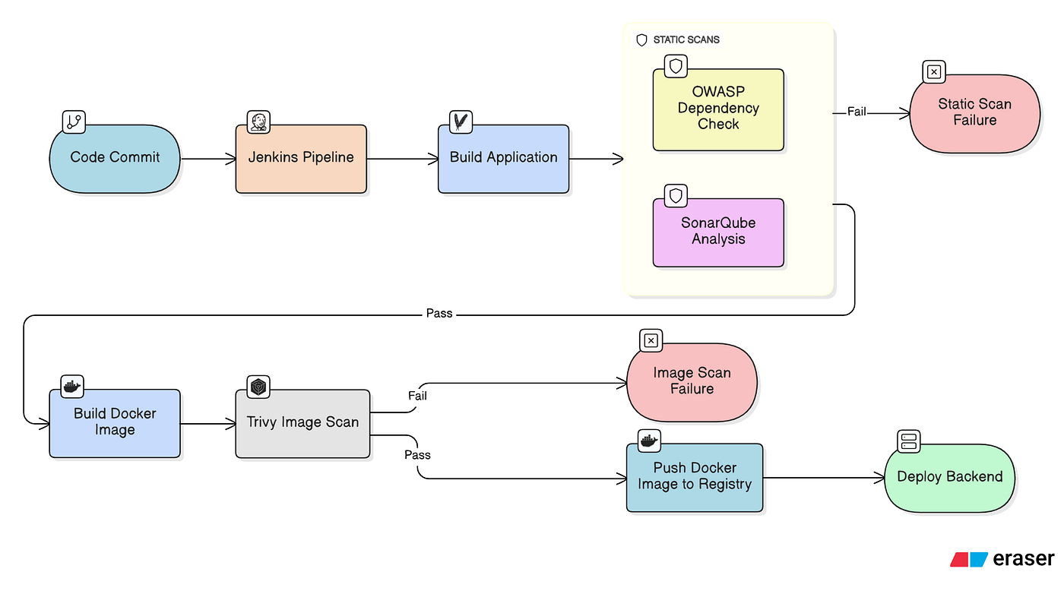

Slide 6
Source Code Management
01.
02.
03.
GIT & GITHUB
CODE TRIGGER
BRANCHING
Code was maintained on Github
Seperate Branches for Each Member was ensured
Poll SCM was used to detect new commit.

Slide 7
Contenerization
Images build with docker-compose.yaml defined
Jenkins trigger the docker compose command
Images are getting pushed to dockerhub after successfull build
Each docker image is given a unique number which is consecutive in nature

Slide 8
01.
02.
DEPLOYMENT
SERVICE
Deployment is getting started to always keep 2 pods running.
A Service is getting started by jenkins for load balancing between Pods and for single point of connection.
Deployment Strategy
03.
04.
REPLICASETS
POD IMPLEMENTATION
Two Replicasets of pods are being Created.
Two containers are being started in each pod, one for backend and one for frontend.

Slide 9
Configuration & Secrets Management
SECRET HANDLING
Credentials of Dockerhub, Minikube and SonarQube are Saved In jenkins only.
ENVIORNMENT VARIABLES
HARDCODING AVOIDED
All Enviornment Variables excluding credentials are saved in yaml files of kubernetes.
Hardcoding of credentials is strictly avoided.

Slide 10

Prometheus and Grafana are used for Monitoring
Monitoring & Logging
Kubernetes Monitoring Dashboard is Used in Grafana
CPU & Memory Usage, resource efficiency and Cost Monitoring

Slide 11


Challenges Faced
Frontend and Backend was giving problems in Starting
Prometheus and Grafana was starting on Private IP, it was not accessible outside the VM, implimented reverse proxy to expose it on internet
SonarQube was failing and not allowing the pipeline to proceed due to bad, code quality, handled it lateron.

Slide 12
THANK YOU
31 January 2026

